Slide 1

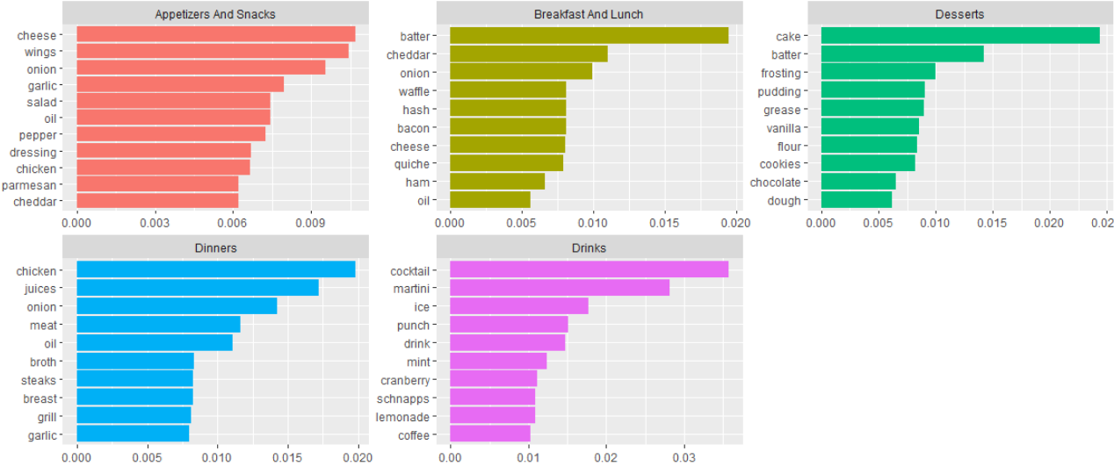
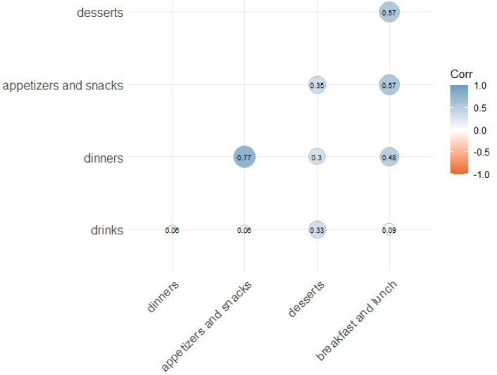
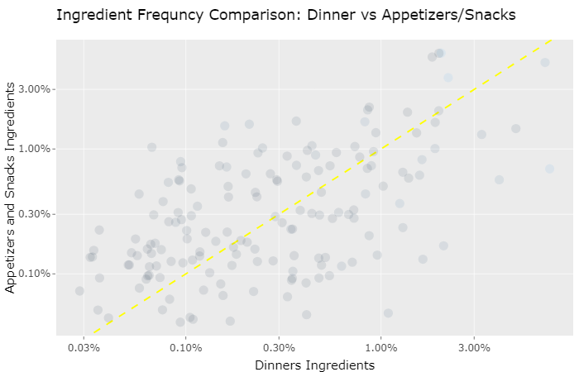
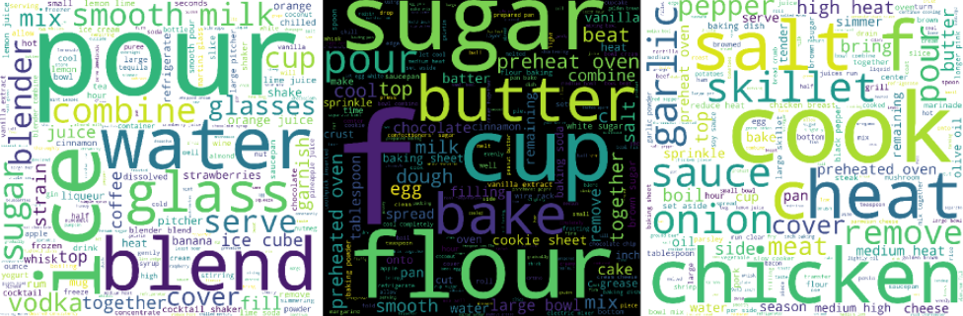
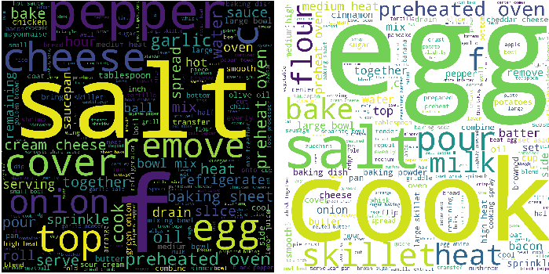
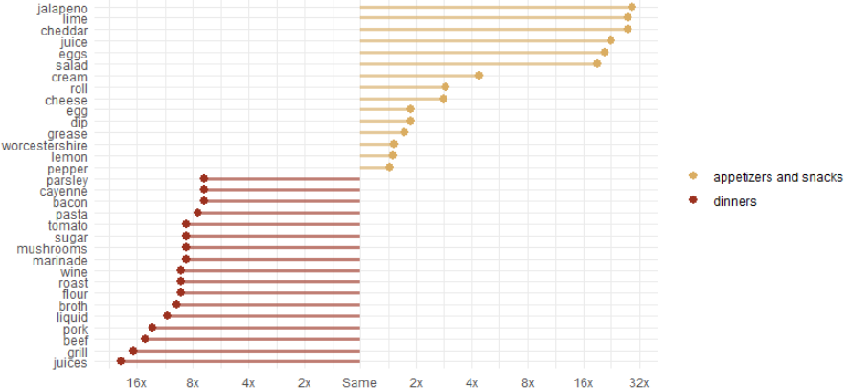
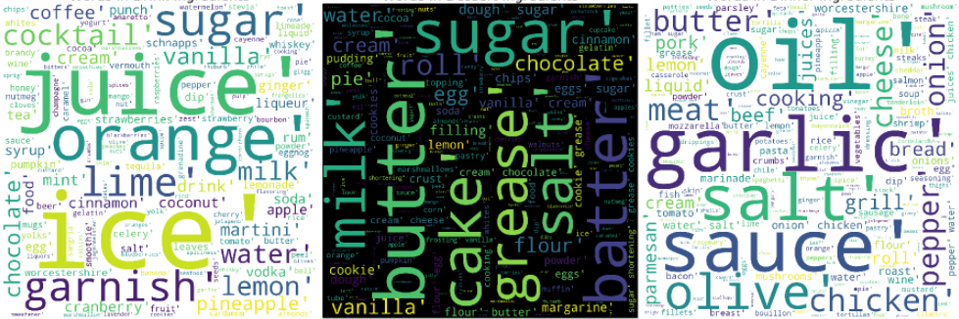
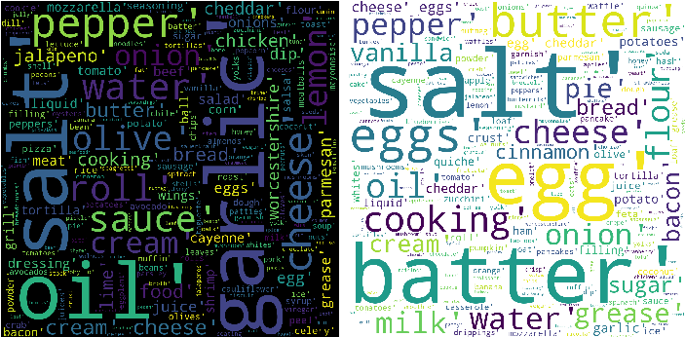
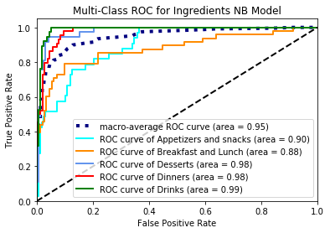
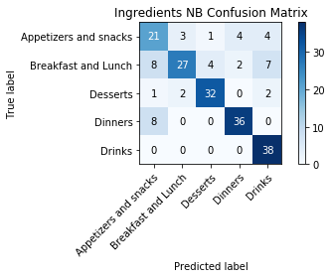
The FoodBase Corpus Analyzing the Predictability of Meal’s Type by its Ingredients and Characteristics Patrick Aquino and Christopher Fiaschetti, Georgetown University
Introduction
About the Data
Ingredients TF-IDF
Our group is interested in labelling meal types by the recipe ingredients:
Can a reliable model be built with this dataset to classify a recipe as an Appetizer and Snack, Breakfast and Lunch, Dessert, Dinner, or Drink?
FoodBase Corpus: a New Resource of Annotated Food Entities by Gorjan Popovski, et. al
We utilized the FoodBase_curated.xml data. One initial problem we have with this file is it hard to conduct EDA on this format. Thus, our first procedure is to convert it into a data frame.
Exploring the Data
Once we have converted the data, we explored what each meal contains in terms of specific ingredients and recipe instructions (in both R and Python).
Meals with Most Similarity: Dinner and Appetizer/Snacks
Wordcloud: Recipe Instructions (First) Ingredients (Second)
Drinks Dessert Dinner App/Snacks Bfast/Lunch
Prediction Models
Conclusion
Methods
Breakfast and Lunch is the most versatile food grouping.
Appetizers and Snacks and Dinners are the closest to each other.
Drinks is the most distinguishable category.
Ingredients models are better than Tags models.
NB Ingredients Model is the most accurate.
Models were developed to predict the classification of a recipe by both Ingredients and Tags, respectively.
KNN, SVM, Decision Trees, and Naïve Bayes were utilized.
Results
The NB Ingredients Model proved to be the best model.
F1 Score: .76 Precision: .77 Recall: .78 Macro-AVG AUC: .95
Even in our best model, 26% of the misclassifications involved Appetizers and Snacks being classified as Dinners (vice versa)

